Slide 1
Springboard Capstone Presentation
Titanic
Who survived the “unsinkable” ship?
by Stefani Clark

Slide 2
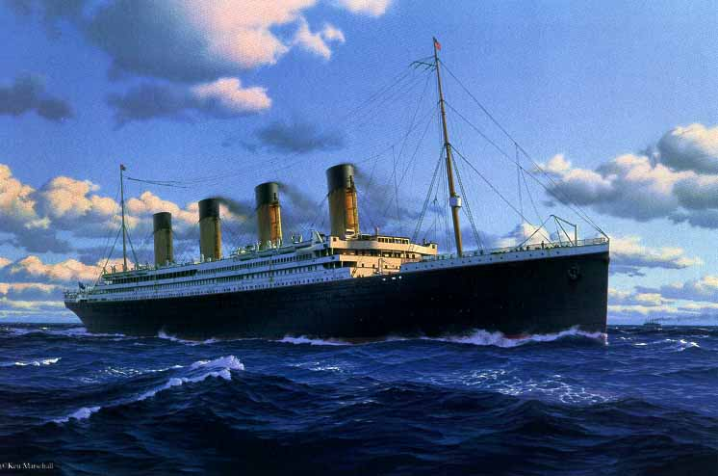
The Titanic The world’s first unsinkable ship took 3 years to build and less than 3 hours to sink. Who will Survive?

Slide 3

Post data analysis of the Titanic survivors has shown a significant correlation between the class of ticket purchased and Survival!
Lets see what the models tell us ………………

Slide 4
Titanic dataset metadata…
Id : a unique number
Survival : 1=yes, 0=no
Passenger class : 1=Upper, 2=Middle or 3=Lower
Name (examples: "Braund, Mr. Owen Harris", "Heikkinen, Miss. Laina")
Sex : female/male
Age
Number of Siblings/Spouses Aboard
Number of Parents/Children Aboard
Ticket number
Passenger Fare
Cabin
Port of Embarkation

Slide 5
Exploratory data insight….
The majority (64.8%) of the passengers are male.
The majority are between 20 and 40 yrs. of age, with the median age of 28 yrs. Children were also onboard, as 44 passengers out of the 714 documented were of age below 6 years old.
Tickets sold by passenger class (first, second, third) show 24% are in the upper class, 21% in the middle class, 55% in the third class.
The Age column has roughly 20% of missing data and the Cabin has 77%.
342 out of the 891 people in the dataset survived, which corresponds to a 38.4% survival rate.

Slide 6
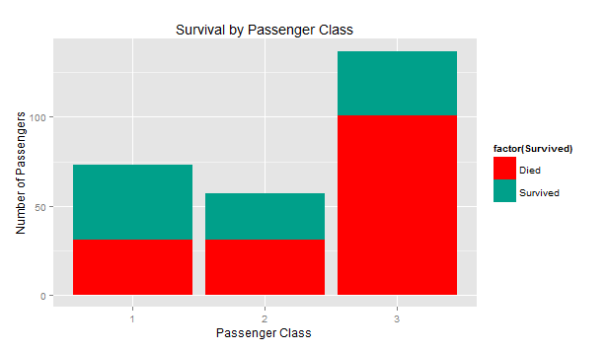
Survival by Passenger Class First Class had the highest number of survivors!
Costs of the different class of tickets:
First Class (parlour) £870/$4,350 ($83,200 today) First Class (berth) £30/$150 ($2975 today) Second Class £12/$60 ($1200 today) Third Class £3 to £8/$40 ($298 to $793 today)

Slide 7
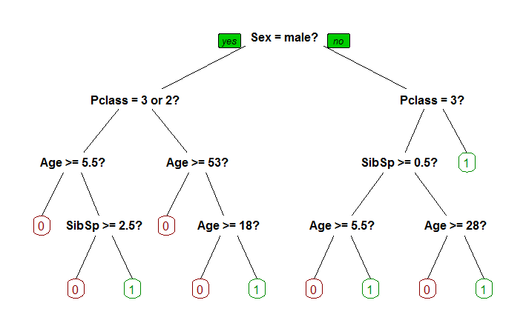
The Decision Tree model showing primary splits and highest correlation to survival are first gender, more females survived in all tree splits. * green “leaf”, terminal nodes are number ones (1 ) for Survived.
The model was trained on 70% of the passengers in the dataset where 30% were kept out and stored in a test dataset. This technique is known as cross validation: the test model was used to score the model. In addition, the model was ran against the original Kaggle “unknown” Test dataset and submitted to Kaggle for scoring.

Slide 8
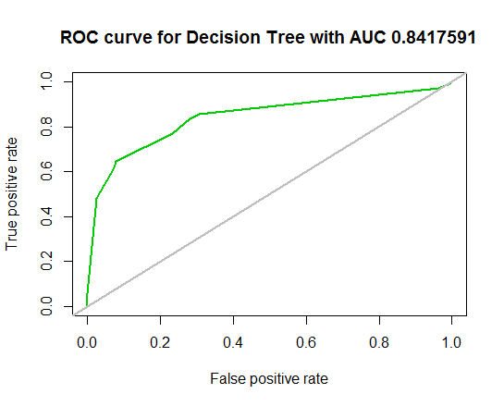
Decision Tree ROC and AUC

Slide 9
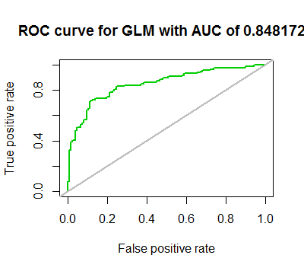
The GLM model showing a high correlation to survival based Passenger Class, First class having the highest number of survivors and Third class having the highest loss. GLM creates a response variable where the response variable is log odds log of odds, a value between 0 and 1 (where 1 is Survived). For GLM we created a threshold of 0.5 where we found we had the highest Accuracy score of 0.7894737
The model was trained on 70% of the passengers in the dataset where 30% were kept out and stored in a test dataset. This technique is known as cross validation: the test model was used to score the model. In addition, the model was ran against the original Kaggle “unknown” Test dataset and submitted to Kaggle for scoring

Slide 10
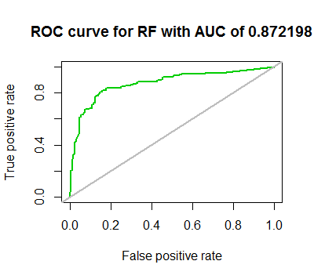
The Random forest ensembles weak learners into a strong learner. The process first randomly selects m variables (where m << M), then finds the predictor variable that provides the best split among m variables. Next, the process grows the full tree without pruning. In the end, we can obtain the predicted result of an example from each single tree. As a result, we can get the prediction result by taking an average or weighted average (for regression) of an output or taking a majority vote (for classification).
The model was trained on 70% of the passengers in the dataset where 30% were kept out and stored in a test dataset. This technique is known as cross validation: the test model was used to score the model. In addition, the model was ran against the original Kaggle “unknown” Test dataset and submitted to Kaggle for scoring.

Slide 11
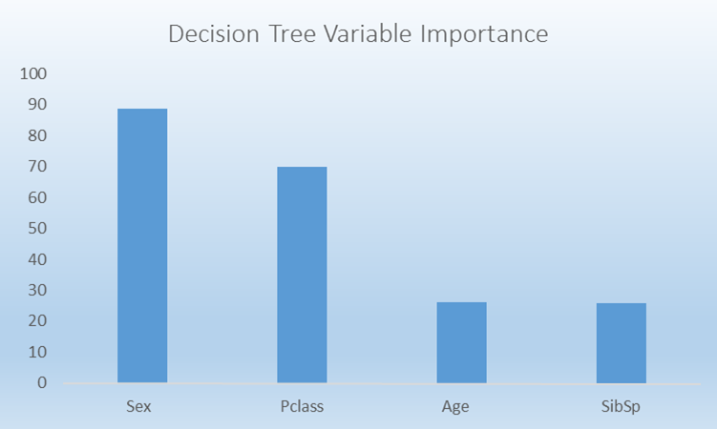
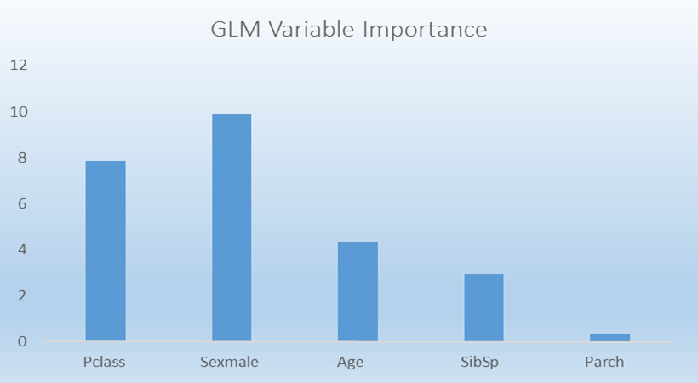
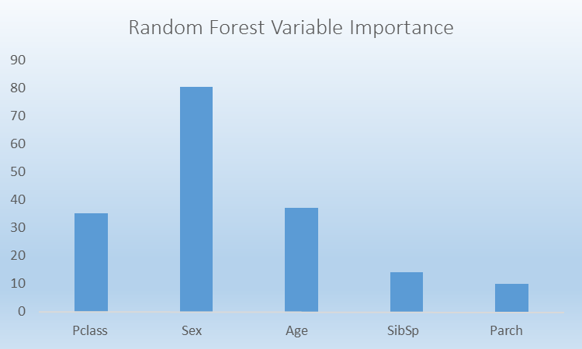
Examination of Variable Importance

Slide 12
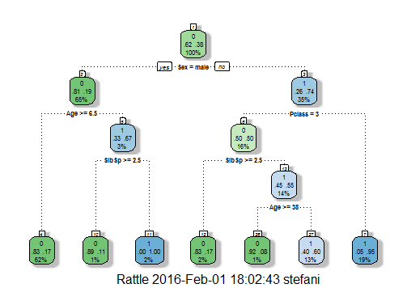
Final model selection
The Decision Tree model produced the highest overall Accuracy score . However, I would have expected Random Forest to produce better results and overall higher accuracy. I suspect more work on feature engineering is required to improve the RF score.

Slide 13
Questions & Answers

